Slide 1

Follow Safe Work Practices for Infection Control
HLTWHS002 - Follow safe work practices for direct client care (Release 2)

Slide 2



All care facilities, no matter how advanced or sophisticated, face the risk of infections. Infections can have significant consequences.
They may cause hospitalisation or even the loss of life in the worst-case scenario.
Fortunately, infections are preventable.
They can be avoided through proper infection prevention and control practices.
These practices aim to stop the spread of infections.
Follow Safe Work Practices for Infection Control

Slide 3
You have the responsibility to ensure your clients' health, safety, and wellness.
To achieve this, you must understand the essential role that you play in infection control.
This includes implementing standards and additional precautions.
This also involves following the correct procedures in handling incidents and equipment.
You must also be able to assess and identify risks of infection so that you can record and report them accordingly.
Follow Safe Work Practices for Infection Control

Slide 4
In this chapter, you will learn how to:
follow standard precautions to prevent the spread of infection
recognise situations when additional infection control procedures are required
apply additional infection control precautions
identify and report risks of infection.
Follow Safe Work Practices for Infection Control

Slide 5

State/Territory Legislation for Infection Control
Infection control legislation provides a basis for safe work practices.
Each state/territory has their own legislation related to infection control.
Infection control provisions are found in public health legislation for each state/territory.
Follow Safe Work Practices for Infection Control

Slide 6

3.1
Follow Standard Precautions to Prevent the Spread of Infection

Slide 7

As a care worker, you are often exposed to elements that can cause infections.
Compared to others, you are at a higher risk of acquiring infections and being a source of infection to clients, visitors, and other workers.
Follow Safe Work Practices for Infection Control

Slide 8
The spread of infection happens when pathogens are transferred from one person to another.
Infections can be transmitted to people through:
breathing in of airborne pathogens
skin contact with contaminated objects
consuming contaminated food
contact with contaminated body fluids.
Follow Safe Work Practices for Infection Control

Slide 9
To reduce risks of infection, you must understand and comply with the standard precautions of your organisation.
Standard precautions are applied to all client care, regardless of infection status.
These are basic precautions for infection control and prevention that every health worker must be aware of.
Follow Safe Work Practices for Infection Control

Slide 10
Standard precautions include:
hand hygiene practices
hand care practices
use of personal protective equipment (PPE)
respiratory hygiene and cough etiquette
cleaning procedures
handling, transporting, and processing of linen
Follow Safe Work Practices for Infection Control

Slide 11
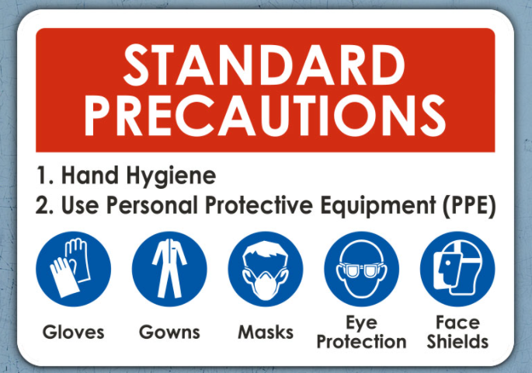
Standard precautions include:
disposal of contaminated waste
handling and disposal of sharps.
Follow Safe Work Practices for Infection Control

Slide 12
3.1.1 Hand Hygiene Practices
Every day, you come across potential infections.
You will interact with potentially infected clients, equipment, surfaces, and substances.
As a result, you get exposed to various pathogens that can cause infections.
If you are not careful, you can spread these to people or surfaces when you:
touch your eyes, nose or mouth
cough or sneeze into your hands, then touch people or surfaces
touch surfaces with dirty hands
prepare or eat food with unwashed hands.
Follow Safe Work Practices for Infection Control

Slide 13
One of the most effective ways to protect yourself and the people around you from getting sick is through proper hand hygiene.
Hand hygiene can be even more effective when performed during key moments when you are more likely to get and spread pathogens.
Hand hygiene practices in a care setting include:
handwashing
hand rubbing.
Follow Safe Work Practices for Infection Control

Slide 14
Handwashing
Handwashing is considered one of the simplest yet most effective measures to prevent infections.
It is performed when the hands are visibly dirty or visibly soiled with blood or other body fluids.
It involves the use of water and soap (either microbial or antimicrobial) or a soap solution.
Follow Safe Work Practices for Infection Control

Slide 15
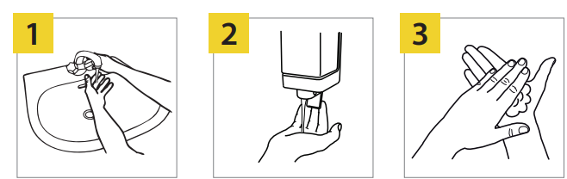
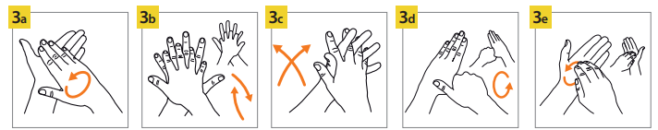
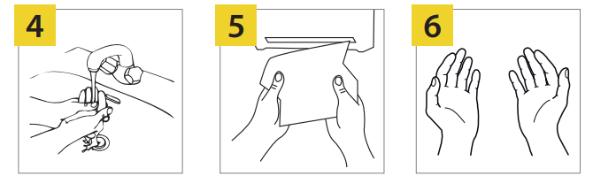
The image below illustrates how to perform handwashing:
Follow Safe Work Practices for Infection Control

Slide 16
The steps to handwashing are as follows:
Wet your hands with clean, running water (preferably warm).
Turn off the tap and apply soap to the hands.
Lather your hands by rubbing them together with the soap, including:
Palm to palm
Back of hands
In between fingers and back fingers
Follow Safe Work Practices for Infection Control

Slide 17

The steps to handwashing are as follows:
Around thumbs
Tips of fingers
Rinse your hands well under clean, running water.
Dry your hands using a clean towel or air dry them.
Follow Safe Work Practices for Infection Control

Slide 18
These are some of the things that you need to remember when washing your hands:
Handwashing should only be performed in designated handwashing basins.
Avoid refilling old containers for liquid soap, cleaners, and disinfectants to avoid contamination.
Use non-antimicrobial soaps after social contact and for visibly soiled hands.
Do not use hot water because this can irritate your skin, instead use warm water.
Do not immediately use an alcohol-based hand rub (ABHR) after handwashing.
Follow Safe Work Practices for Infection Control

Slide 19
Hand Rubbing
Hand rubbing involves using alcohol-based hand rubs (ABHRs), hand sanitisers, gels, or liquids.
It is performed when:
the hands are not visibly soiled
water and soap are not readily available.
Follow Safe Work Practices for Infection Control

Slide 20

Before performing hand rubbing, ensure that your hands are clear of obstructions.
Remove any hand and arm jewellery and watches.
Follow Safe Work Practices for Infection Control

Slide 21
Then, follow this step-by-step process:
Apply a palmful of ABHR on both of your hands.
Rub your palms against each other in a circular motion.
Rub your right palm over the back of your left hand and vice versa.
Rub your palms together, this time with your fingers interlaced.
Rub the backs of your fingers in one hand with the palm of your other hand.
Rub both of your thumbs.
Continue rubbing until your hands are dry.
Follow Safe Work Practices for Infection Control

Slide 22
The entire procedure takes approximately 20 to 30 seconds.
These are the things that you must remember when hand rubbing:
The product that you choose must have an alcohol concentration between 60 to 95 per cent.
Avoid using products that do not have the required alcohol concentration.
Hand rubs should be made readily available through dispensers near the points of care or in small bottles for carrying with you around.
Follow Safe Work Practices for Infection Control

Slide 23

3.1.2 Hand Care Practices
Intact skin serves as your primary defence mechanism against infection.
If you damage your skin, you become prone to infection.
You can also harbour pathogens that can be transmitted to your clients or other care workers.
Follow Safe Work Practices for Infection Control

Slide 24
Hand hygiene practices may sometimes cause skin reactions such as contact dermatitis.
Irritant contact dermatitis
It happens when there is skin drying due to frequent and repeated use of hand hygiene products. Symptoms include:
dryness
irritation
itching
In major cases, cracking and bleeding can be observed.
Follow Safe Work Practices for Infection Control

Slide 25
Hand hygiene practices may sometimes cause skin reactions such as contact dermatitis.
Allergic contact dermatitis
It manifests when you are allergic to any ingredient in a hand hygiene product.
This is usually associated with fragrances and preservatives.
Follow Safe Work Practices for Infection Control

Slide 26

Skin reactions need to be addressed with hand care procedures to reduce the risk of skin damage and irritation.
Follow Safe Work Practices for Infection Control

Slide 27
Ways That Help Maintain Intact Skin
Avoid using products that may irritate the skin.
Avoid washing hands with soap and water immediately before or after using an alcohol-based hand rub, as this may cause dermatitis.
Ensure that hands are completely dry and clean before donning gloves.
Avoid using hot water for handwashing.
Regularly use moisturisers.
Follow Safe Work Practices for Infection Control

Slide 28
Moisturising Lotion and Creams
Only use lotions and creams provided or recommended by the care facility to ensure compatibility with other hand hygiene products used in the facility.
Moisturise regularly with creams and lotions to prevent or minimise skin dryness or irritation.
Follow Safe Work Practices for Infection Control

Slide 29
Appropriate Hand Hygiene Products
Products with fragrances, colours and preservatives should be avoided or minimized as this products can lead to skin irritation.
Emollient-containing ABHRs are recommended which are known to lead to improvements in irritant contact dermatitis.
Follow Safe Work Practices for Infection Control

Slide 30
Correct Handwashing and Hand Rubbing Practices
Do not use an ABHR after washing your hands with soap and water to prevent dermatitis.
Gloves should only be worn when the hands are fully dry.
Hot water should not be used for handwashing.
The quality of the paper towels should be acceptable so that there is no irritation when used.
Follow Safe Work Practices for Infection Control

Slide 31
Other Hand Care Guidelines:
Jewellery must be kept at the absolute minimum.
Wear appropriate attire like cardigans or jackets.
Chipped or old nail polish must be removed.
Avoid biting or chewing nails.
Follow Safe Work Practices for Infection Control

Slide 32
3.1.3 Use of Personal Protective Equipment (PPE)
Personal protective equipment (PPE) is a piece of wearable equipment that can be used alone or in combination with other PPE.
PPE reduces the risk of infection by performing the following functions:
Protecting your body parts, membranes (e.g. nose, mouth, and eyes), and clothing from infectious particles
Preventing contamination of skin and clothing by pathogens in the environment
Follow Safe Work Practices for Infection Control

Slide 33
When choosing the type of PPE to be used, consider the following factors:
Risks to health and safety
Task or activity to be performed
Nature of work and any hazard associated with the work
Requirements of relevant standards and codes of practice
Size, fit, and comfort for the person wearing the PPE
Compliance with applicable Australian Standards
Follow Safe Work Practices for Infection Control

Slide 34
The PPE must only be used when deemed necessary.
Overuse of PPE can lead to negative effects such as:
interference with the quality of care given to clients
increased waste and costs
shortages of PPE that can result in inappropriate use
environmental issues relating to disposable PPE, washing agents, and chemicals.
Follow Safe Work Practices for Infection Control

Slide 35
General PPE Guidelines
PPE should be worn in this sequence:
Gown or waterproof apron
Surgical mask or respirator
Goggles or face shield
Gloves
Follow Safe Work Practices for Infection Control

Slide 36
PPE should be removed before leaving a care client’s room or immediately outside the client’s room.
It must be done in the following sequence:
Gloves
Goggles or face shield
Waterproof apron or gown
Surgical mask or respirator
Follow Safe Work Practices for Infection Control

Slide 37
3.1.3.1 Gloves
Gloves are designed to protect yourself and your clients from pathogens that can be transmitted via hand contact.
They are worn when:
anticipating direct contact with infectious substances or materials
handling visibly soiled or potentially contaminated client care equipment
anticipating potential exposure to toxic drugs during the administration
using chemicals when cleaning.
Follow Safe Work Practices for Infection Control

Slide 38
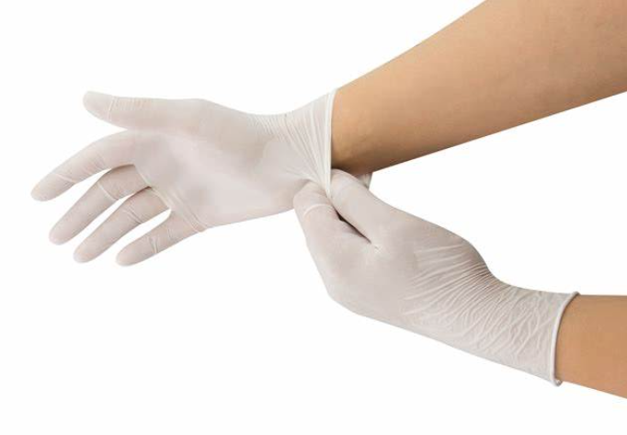
Gloves are not required for routine care activities.
These are activities where contact is limited to the intact skin of persons.
Follow Safe Work Practices for Infection Control

Slide 39
Important Guidelines on How to Use Gloves Correctly
The following are guidelines for appropriate glove use:
Perform hand hygiene before and after using gloves.
Change gloves between conducting clean and dirty procedures.
Change gloves in between interactions with different clients.
Gloves that are used for care activities should not be reused.
Follow Safe Work Practices for Infection Control

Slide 40

When touching everyday objects, do not wear gloves.
This will help you avoid cross-contamination.
Follow Safe Work Practices for Infection Control

Slide 41
Types of Gloves
Common types of gloves used in a care setting with their corresponding description.
Type of Gloves | Description
Examination gloves | Disposable gloves to prevent contamination between the examiner and the person being examined Common materials include latex, vinyl, and polymer
Follow Safe Work Practices for Infection Control

Slide 42
Common types of gloves used in a care setting with their corresponding description.
Type of Gloves | Description
Surgeon’s gloves | Used in operating rooms to prevent the contamination of a surgical wound Common materials include natural and synthetic rubber
Follow Safe Work Practices for Infection Control

Slide 43
Common types of gloves used in a care setting with their corresponding description.
Type of Gloves | Description
Non-medical gloves | Used for non-care activities like cleaning of contaminated equipment or food service
Follow Safe Work Practices for Infection Control

Slide 44
Fitting of Gloves
1
Perform the necessary hand hygiene.
2
Fit gloves and adjust the cuffs. If necessary, extend to cover the wrist of your gown.
Follow Safe Work Practices for Infection Control

Slide 45
Removing and Disposing of Gloves
1
Grip the cuffs of one glove. Peel the glove away from you by pulling it inside out.
2
Remove the other one by sliding the fingers of the ungloved hand under the glove.
3
Peel the second glove over the first glove.
4
Peel the second glove over the first glove.
Follow Safe Work Practices for Infection Control

Slide 46
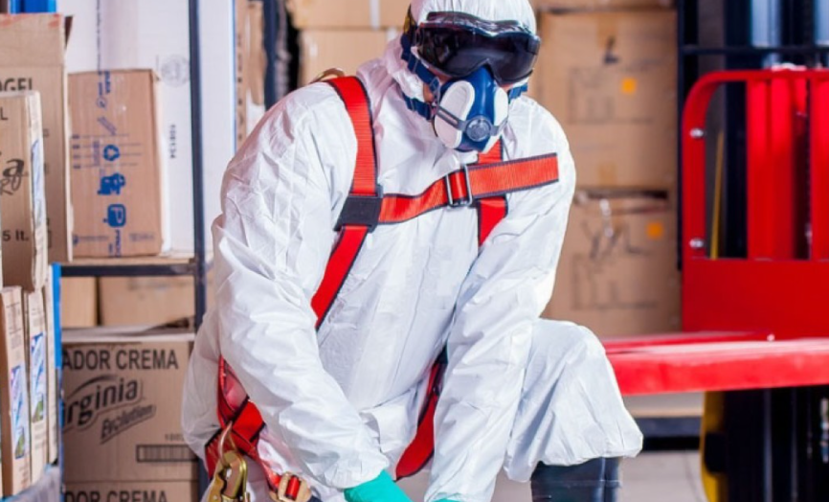
3.1.3.2 Protective Clothing
Protective clothing protects the care workers’ uniforms, clothing, and exposed body parts.
This includes impermeable gowns and plastic aprons.
Follow Safe Work Practices for Infection Control

Slide 47
Protective clothing must be worn when:
anticipating exposure to blood, body substances, secretions, or excretions
anticipating close contact with clients
anticipating contact with materials or equipment that can possibly contaminate skin and clothing.
Before leaving the client's room, aprons and gowns should be removed to avoid contaminating the environment.
Follow Safe Work Practices for Infection Control

Slide 48
Types of Protective Clothing
In the table below, you can see the different types of protective clothing and their respective descriptions.
Type of protective clothing | Description
Plastic apron | Worn for general use and when contact with a client is likely Used for low-risk procedures Single-use and disposable
Follow Safe Work Practices for Infection Control

Slide 49
In the table below, you can see the different types of protective clothing and their respective descriptions.
Type of protective clothing | Description
Gown | Choice of sleeve length varies depending on the procedure, the volume of body substances to be encountered, and the risk of exposure Covers a worker’s exposed body area Single-use and disposable
Follow Safe Work Practices for Infection Control

Slide 50
In the table below, you can see the different types of protective clothing and their respective descriptions.
Type of protective clothing | Description
Full body gown | Worn when contact with non-intact skin is likely Worn when anticipating splash or splatter of blood and other body fluids Always worn in combination with other PPE Single-use
Follow Safe Work Practices for Infection Control

Slide 51
In the table below, you can see the different types of protective clothing and their respective descriptions.
Type of protective clothing | Description
Sterile gown | Used for procedures performed in an aseptic field
Follow Safe Work Practices for Infection Control

Slide 52
Fitting Protective Clothing
1
Put on the gown. Fully cover the torso from the neck to knees and arms to the end of your wrists. Wrap around the back.
2
Fasten the ties at the neck and the back.
3
Tuck your sleeves under the glove cuffs of the gown.
Follow Safe Work Practices for Infection Control

Slide 53
Removing and Disposing of Protective Clothing
1
Using clean hands, untie or break the ties at your back and neck.
2
Pull from the neck and shoulders, then arms. Remember to touch only the inside of the gown because the outside is already contaminated.
3
Turn the gown inside out.
Follow Safe Work Practices for Infection Control

Slide 54
Removing and Disposing of Protective Clothing
4
Roll the gown into a bundle.
5
Discard the gown into the designated waste container.
6
Wash hands.
Follow Safe Work Practices for Infection Control

Slide 55
3.1.3.3 Masks
Mucous membranes, such as those found in the nose and mouth, serve as entry points for infectious microorganisms.
The use of masks reduces the risk of exposure to splashes of blood, body substances, secretions, and excretions.
Follow Safe Work Practices for Infection Control

Slide 56
Important Guidelines on How to Use Masks Correctly
Change your mask when it becomes soiled or wet.
Do not touch your mask while wearing it.
Never reuse disposable masks. Do not fold it or put it in your pocket for later use.
Never reapply when it has already been removed. Do not leave your mask hanging around your neck. Discard your mask in the appropriate waste disposal area.
Follow Safe Work Practices for Infection Control

Slide 57
Types of Masks
In a care setting, two types of masks are commonly used depending on the situation.
Type of mask | Description
Surgical mask | Loose-fitting and single-use Includes surgical, isolation, dental, and medical procedure masks Does not form a seal around the nose and mouth
Follow Safe Work Practices for Infection Control

Slide 58
In a care setting, two types of masks are commonly used depending on the situation.
Type of mask | Description
N95 respirators | Close facial fit Forms a seal around the nose and mouth Single-use Not meant for the use of the general public
Follow Safe Work Practices for Infection Control

Slide 59
Fitting the Mask
Position the surgical mask over your mouth and nose.
Fasten the ties or tapes above and below your ears at the back of your head.
Removing and Disposing of the Mask
Using clean hands, untie or break the ties at the back of your hand.
Touch only the ties of the masks and discard them in the designated waste disposal.
Perform hand hygiene.
Follow Safe Work Practices for Infection Control

Slide 60
3.1.3.4 Eye Protection
Care workers must wear eye protection during certain workplace activities.
This applies to activities that involve splashes or sprays of blood, body fluids, secretions, or excretions.
Eye protection must also be worn for any wound irrigation procedure where there is a risk of sprays or splashes.
Follow Safe Work Practices for Infection Control

Slide 61
Important Guidelines on How to Use Eye Protection Correctly
If eye protection is disposable, dispose of it immediately in the proper waste disposal area.
If eye protection is reusable, it should be sent to a central area for reprocessing before it can be used again.
Choose eye protection that does not interfere with visual acuity.
Choose a size that fits securely to protect you from splashes from the side.
Follow Safe Work Practices for Infection Control

Slide 62
Types of Eye Protection
The types of eye protection in a care setting and their description are shown in the table below.
Type of eye protection | Description
Goggles | Considered the most reliable eye protection but do not provide protection to other parts of the face
Face shields | Can either be single-use or reusable Alternative to goggles
Follow Safe Work Practices for Infection Control

Slide 63
The types of eye protection in a care setting and their description are shown in the table below.
Type of eye protection | Description
Safety glasses | Provide a lower level of protection than goggles Generally not recommended for infection control use
Follow Safe Work Practices for Infection Control

Slide 64
Fitting of Eye Protection
Position the face shield or protective eyewear over the face and eyes.
Adjust as necessary.
Removing and Disposing of Eye Protection
Using clean hands, remove the eye protection equipment. Make sure to handle only the sides or the back.
Discard in the designated waste area or reprocess and store properly.
Follow Safe Work Practices for Infection Control

Slide 65
When removing eye protection, do not touch the front and sides of the equipment.
These surfaces are prone to contamination by sprays, splashes or droplets.
Some eye protection equipment is non-disposable.
This means that they can be reused. Place non-disposable eye protection in a secure and clean container.
Remember to clean and disinfect it after every use.
Follow Safe Work Practices for Infection Control

Slide 66
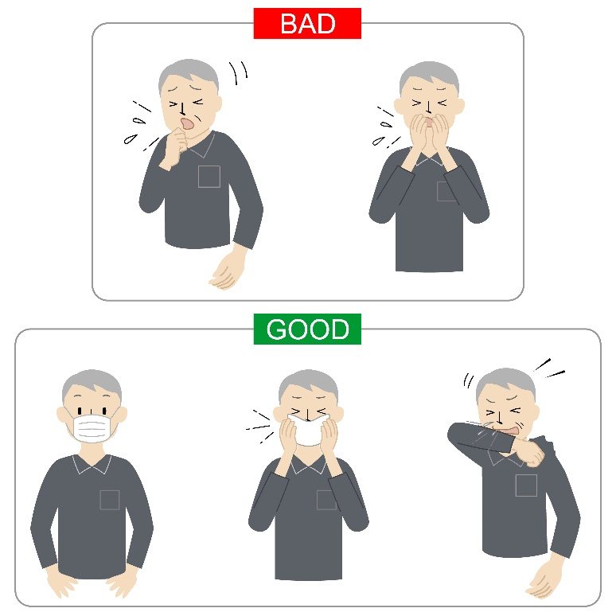
3.1.4 Respiratory Hygiene and Cough Etiquette
One of the means by which an infection can spread is through droplets released during coughing or sneezing.
This may cause others to get sick.
Follow Safe Work Practices for Infection Control

Slide 67
Cover Your Cough or Sneeze
When coughing or sneezing, use a tissue or mask to cover your nose and mouth.
Dispose of used tissues properly by collecting them in a small plastic bag.
A cloth handkerchief should be avoided because it can serve as a breeding ground for germs.
Always sneeze or cough away from people.
If a tissue or mask is unavailable, cough or sneeze into your upper sleeve or elbow and avoid sneezing in your hands.
Follow Safe Work Practices for Infection Control

Slide 68
Sanitise
Perform hand hygiene procedures after suspected contact with respiratory droplets.
Sanitise surfaces you have coughed on, sneezed on or touched with contaminated hands.
Wipe items that are frequently touched, such as cell phones, keys, and credit cards.
Follow Safe Work Practices for Infection Control

Slide 69

Stay at Home
As a care worker, you interact with clients and co-workers.
When you are experiencing symptoms of illness, it is still best to stay at home and rest.
Distance yourself from people, especially high-risk individuals.
Follow Safe Work Practices for Infection Control

Slide 70
Your Responsibilities in Relation to Respiratory Hygiene
Steps you can do to ensure respiratory hygiene in the workplace:
Place a surgical mask on a coughing person if they can tolerate.
Try to separate people with respiratory symptoms at least two meters away or in a separate room from others, if possible.
Educate others about practising proper respiratory hygiene and cough etiquette.
Provide resources for performing hand hygiene in or near waiting areas.
Place visual information like signs and posters where possible.
Follow Safe Work Practices for Infection Control

Slide 71
3.1.5 Cleaning Procedures
Environmental cleaning is part of the standard precautions for infection control and prevention.
It involves reducing the number of pathogens on surfaces to minimise the risk of infection.
Some of the activities performed when cleaning include the following:
Waste removal
Damp dusting
Mopping
Washing
Drying
Follow Safe Work Practices for Infection Control

Slide 72
Preparation
First, you must prepare to clean. Preparation involves:
preparing the cleaning solution according to the instructions of the manufacturer
wearing the appropriate PPE
performing hand hygiene
preparing a checklist of everything that you need to clean to make sure that you do not miss anything
removing clutter.
Follow Safe Work Practices for Infection Control

Slide 73
General Environmental Cleaning Techniques
As a general rule, you must clean:
from high to low (top to bottom)
from least contaminated (least soiled) to most contaminated (most soiled)
from environmental surfaces to floors.
Follow Safe Work Practices for Infection Control

Slide 74

Floors
Except for spills, the use of disinfectants is not necessary because floors are minimally touched areas.
Follow Safe Work Practices for Infection Control

Slide 75
Do the following when mopping floors:
Perform dry mopping to collect dust and debris from the floor in preparation for wet mopping.
Submerge the mop in the cleaning solution and perform wet mopping.
Proceed from the area farthest from an exit and mop while walking towards the exit.
Change the mops and cleaning solutions as frequently as needed.
Follow Safe Work Practices for Infection Control

Slide 76
Toilets
Toilets have a higher risk of being contaminated than general care areas and should therefore be cleaned last. When cleaning toilets:
clean both surfaces and fixtures within the toilet, including walls, sinks, faucets, handles, toilet seat, and floors
dry all surfaces using well-wrung cloths or paper towels.
Follow Safe Work Practices for Infection Control

Slide 77
After Cleaning
Once you are done cleaning, you must do the following:
Launder mop heads and reusable cleaning cloths daily or as often as prescribed by your facility’s guidelines.
Clean the housekeeping trolley/cart.
Take reusable PPE to the reprocessing area of your facility.
Complete the required documentation and sign off sheets.
Report anything that needs to be replaced or repaired.
Follow Safe Work Practices for Infection Control

Slide 78
3.1.6 Handling, Transporting and Processing of Linen
Proper handling of dirty linen is essential to preventing exposure and contamination of clothing.
It also helps to avoid the transfer of pathogens.
Three parts of typical movement of clean and dirty linen:
Handling of linen
Storing and transporting of linen
Processing (laundering) of linen
Follow Safe Work Practices for Infection Control

Slide 79
Handling of Linen
There are different types of dirty linen:
Used linen is used but has no visible stains.
Soiled linen has visible stains from different sources.
Infectious linen is used by clients who have been infected by transmissible conditions.
Infested linen is used by clients who have come into contact with parasites.
Follow Safe Work Practices for Infection Control

Slide 80
Handling of Linen
The following precautions and procedures must be practised in the handling of linen:
Before handling linens, wear the appropriate PPE to prevent exposure to blood and body fluids.
Follow Safe Work Practices for Infection Control

Slide 81
The following precautions and procedures must be practised in the handling of linen:
When removing linen from a bed, you must follow these guidelines:
Fold linen towards the centre of the bed.
Place it directly from the bed into the linen hamper.
If linens are soiled (wet), infectious or infested, place them in leak-proof plastic bags. Close the bags immediately.
Keep the dirty linen away from your clothes or uniform at all times.
Follow Safe Work Practices for Infection Control

Slide 82

The following precautions and procedures must be practised in the handling of linen:
As much as possible, dirty linen should not be shaken to reduce the risk of scattering particles that may contain pathogens.
Follow Safe Work Practices for Infection Control

Slide 83
Storing of Linen
Clean linens must not be placed in the same area as dirty linens and ensure that there is clear segregation between them.
Store clean linens in a clean and dry place where they cannot be contaminated by aerosols, dust, moisture, or pests.
Bag linens and place them in a designated area and ensure that access to the storage area of dirty linen is restricted until it is collected to be laundered.
Follow Safe Work Practices for Infection Control

Slide 84
Transporting of Linen
Transport linen in a cleaned and closed linen cart or bag.
When unloading linens from the linen cart or trolley, make sure that you are on a flat and level surface.
You may use the same trolley to deliver clean and dirty linen as long as the trolley has been thoroughly cleaned and dried.
The transport vehicle should have the means to secure linens firmly.
Follow Safe Work Practices for Infection Control

Slide 85
Processing of Linen
Proper processing of linens involves laundering them.
For residential care settings, you may simply assist your client in their laundering tasks.
The typical laundry process involves the following:
Pre-wash (removal of stains)
Main wash
Rinse
Follow Safe Work Practices for Infection Control

Slide 86
3.1.7 Disposal of Contaminated Waste
Contaminated or infectious waste are generated by care facilities during the following activities:
Diagnosis
Treatment
Immunisation
Research
Production or testing of biological materials
Follow Safe Work Practices for Infection Control

Slide 87
Waste may contain infectious material. This may include bodily fluids and contaminants that can cause injury, infection, or disease.
The first step to the safe disposal of contaminated waste is identifying its different types.
Follow Safe Work Practices for Infection Control

Slide 88
If not disposed of correctly, contaminated waste can spread disease and infection through:
punctures, abrasions or cuts
the mucous membranes of the eyes, nose or mouth
inhalation
ingestion.
Follow Safe Work Practices for Infection Control

Slide 89
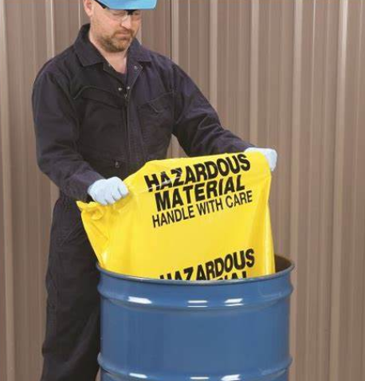
Storage of Contaminated Waste
Storage of contaminated waste should be done in such a way that the threat to health, safety, and environment are minimised.
Follow Safe Work Practices for Infection Control

Slide 90
This can be done by taking the following precautions:
Ensure that the storage area:
is clean, dry, well-ventilated, and free from pests and vermin
has locks that can prevent access by unauthorised persons
has an impermeable and hard-standing floor with good drainage
has adequate water supply for easy cleaning and disinfection
is easily accessible to waste collection vehicles.
Follow Safe Work Practices for Infection Control

Slide 91
This can be done by taking the following precautions:
Cleaning equipment, PPE, and waste bags should be supplied near the storage area.
If any waste is mixed with medical waste, treat that waste as medical waste.
Sharps should be contained in a leak and puncture-proof container.
Follow Safe Work Practices for Infection Control

Slide 92

Collection and Transportation of Contaminated Waste
Waste should never be allowed to accumulate.
It must be collected daily or as frequently as required.
Follow Safe Work Practices for Infection Control

Slide 93
The following guidelines must be followed:
Mobile garbage bins and trolleys must have the following characteristics:
Can be locked, closed, or covered as necessary to prevent the spill of liquids
Are dedicated only to collecting and transporting waste
Have washable and easily cleanable surfaces
Are rigid-walled and puncture-proof
Follow Safe Work Practices for Infection Control

Slide 94
The following guidelines must be followed:
Clean mobile garbage bins and trolleys after each use.
On-site transportation must not be done during peak activity times to minimise exposure.
Waste should not be transported through general or public areas.
Do not use waste chutes for transporting contaminated waste to avoid the risk of bag breaking or waste spilling.
Follow Safe Work Practices for Infection Control

Slide 95
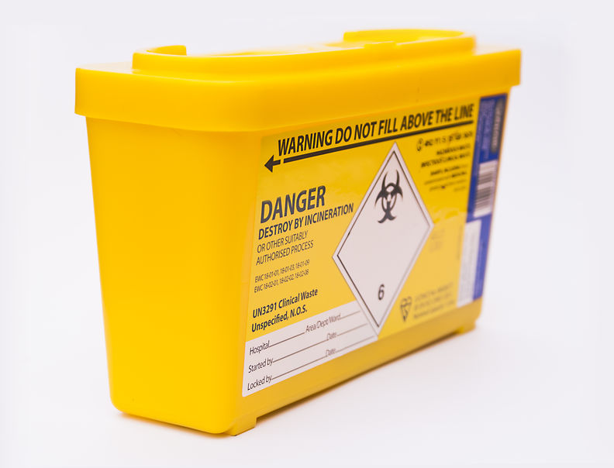
Contaminated waste must be regularly transported from the care facility to proper treatment or disposal area and be collected by a licensed transport company.
The transport vehicle should only be used for the purpose of handling contaminated waste.
Follow Safe Work Practices for Infection Control

Slide 96

3.1.8 Handling and Disposal of Sharps
A sharp is any device or object used to puncture or lacerate the skin.
If not handled properly, sharps can be dangerous.
They can cause penetrating injuries when they pierce the skin and enter body tissue.
Follow Safe Work Practices for Infection Control

Slide 97

They can expose workers and clients to blood-borne viruses, such as:
Hepatitis B
Hepatitis C
Human Immunodeficiency Virus (HIV).
Follow Safe Work Practices for Infection Control

Slide 98
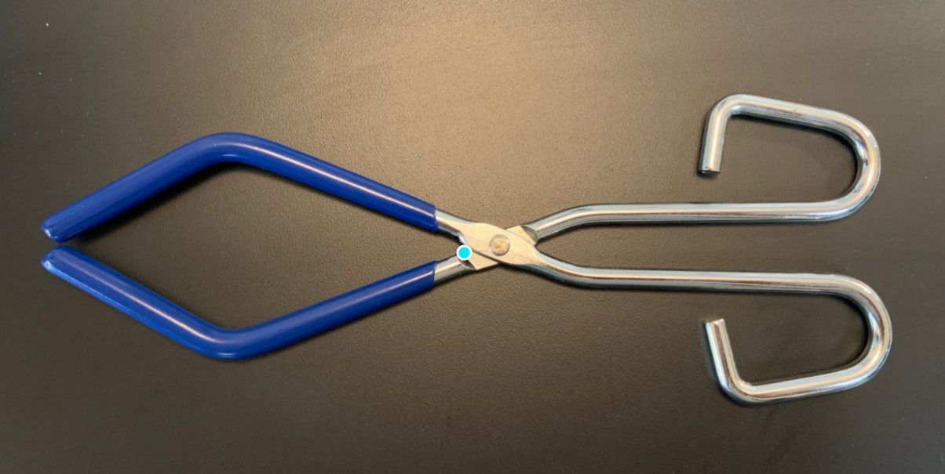
To protect yourself, others, and the environment from harm caused by sharps, you must follow safe handling practices.
The best way to get rid of sharps is to perform the following steps:
Use tongs or other such instruments to pick up the sharp.
Follow Safe Work Practices for Infection Control

Slide 99
To protect yourself, others, and the environment from harm caused by sharps, you must follow safe handling practices.
The best way to get rid of sharps is to perform the following steps:
Store the sharp in a container that:
is made of quality heavy-duty plastic
has a tight-fitting, puncture-proof lid
prevents sharps from falling or sticking out
is properly labelled.
Follow Safe Work Practices for Infection Control

Slide 100
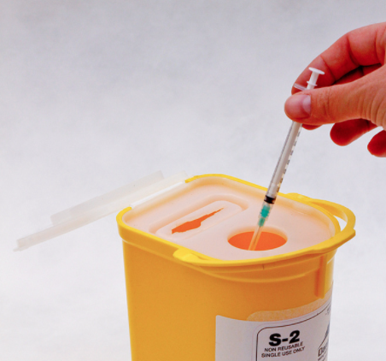
To protect yourself, others, and the environment from harm caused by sharps, you must follow safe handling practices.
The best way to get rid of sharps is to perform the following steps:
Dispose of sharps disposal containers according to the guidelines of your organisation.
Follow Safe Work Practices for Infection Control

Slide 101
When handling sharps, DO NOT:
re-cap or bend used needles
remove the needles from syringes
place them in areas that children can reach
throw sharps in the general trash or put them in the recycle bin.
Follow Safe Work Practices for Infection Control

Slide 102

3.2
Recognise Situations When Additional Infection Control Procedures are Required

Slide 103
You may encounter situations where you will need additional infection control procedures.
These are situations when standard precautions will no longer work to prevent transmission.
Additional infection control procedures include the following:
Additional use of personal protective equipment
Dedicated equipment for infection control
Special ventilation requirements
Follow Safe Work Practices for Infection Control

Slide 104
Additional infection control procedures will be required when:
there are clients who are suspected or confirmed to be infected with transmissible viruses
there are known outbreaks of infectious diseases
the infection was transmitted through either contact, droplets or airborne pathogens.
Follow Safe Work Practices for Infection Control

Slide 105
In order to recognise these situations, follow this step-by-step assessment:
Identify the potential source and type of infection.
Conduct contact tracing.
Assess the need for additional infection control procedures.
Follow Safe Work Practices for Infection Control

Slide 106

3.3
Apply Additional Infection Control Precautions

Slide 107
Additional Precautions are implemented when standard precautions cannot prevent the transmission of infection.
They are also called transmission-based precautions.
These are commonly used during outbreaks (whether confirmed or suspected) to contain infections.
Follow Safe Work Practices for Infection Control

Slide 108
The different types of additional precautions that are based on the routes of transmission are as follows:
Contact precautions
Droplet precautions
Airborne precautions
Follow Safe Work Practices for Infection Control

Slide 109
3.3.1 Contact Precautions
Contact precautions are applied when there is a risk of direct or indirect contact transmission.
Contact transmission is considered the most common mode of transmission.
There are two types of contact transmission:
Indirect transmission
Direct transmission
Follow Safe Work Practices for Infection Control

Slide 110
Indirect transmission is when an infectious agent transfers from a contaminated object/person to a host.
Direct transmission is the second type of transmission which happens when the infection transmits without going through a contaminated object or person.
Follow Safe Work Practices for Infection Control

Slide 111
Contact precautions include the following:
Accommodation
Appropriate PPE
Transportation guidelines
Cleaning
Visitor guidelines
Follow Safe Work Practices for Infection Control

Slide 112
3.3.2 Droplet Precautions
Droplet precautions are applied when there is a risk of droplet transmission.
Droplet transmission occurs through droplets coming from infected persons that happens when an infected person coughs, sneezes or talks.
These droplets can cause infection when they enter directly on a susceptible host's mucosal surfaces.
Follow Safe Work Practices for Infection Control

Slide 113

3.3.3 Airborne Precautions
Airborne precautions are applied when there is a risk of airborne transmission.
Airborne transmission involves aerosols produced when an infected person coughs, sneezes, or talks.
Follow Safe Work Practices for Infection Control

Slide 114
Aerosols
are particles suspended in the air
can be dispersed over long distances and inhaled by a susceptible host
are transmitted through ventilation or air conditioning systems.
Airborne transmission can occur either in the same room or in a different room, depending on the air current.
Follow Safe Work Practices for Infection Control

Slide 115

3.4
Identify and Report Risks of Infection

Slide 116
It is important to identify risks of infection in the workplace promptly.
This will allow your organisation to take the necessary measures to avoid the spread of infection.
Risk of infection refers to the possibility of an infection spreading in the workplace.
Similar to other types of risk, risk of infection is identified by following a risk identification and assessment process.
The difference is that you will observe and record details specific to infections.
Follow Safe Work Practices for Infection Control

Slide 117
Infection Risk Identification and Assessment
First, you must identify the risk and gather as much information as you can about the risk.
Once you have identified basic information about the infection, you can assess the risk.
Similar to assessing other types of risk, you must access and fill out your organisation’s risk assessment form.
Follow Safe Work Practices for Infection Control

Slide 118
Unlike other types of risks, infection is not always observable where infected persons may not show symptoms of infection but may still be carriers of the infectious agent.
For risks of infection, it is important that you investigate thoroughly by:
observing the behaviour of clients, co-workers and visitors
examining existing infection control precautions for any breaches
interviewing persons who may be experiencing symptoms of infection
reviewing client records for information such as history of the illness and recent health complaints.
Follow Safe Work Practices for Infection Control

Slide 119
Reporting Risks of Infection According to Workplace Procedures
After conducting the risk assessment, you will now have a risk assessment document ready.
The next step is to report your findings to your supervisor, following workplace procedures.
Reporting will involve:
filing your report based on workplace procedures
discussing the assessment and recommendations with your supervisor.
Follow Safe Work Practices for Infection Control

Slide 120
Identifying Common Sources of Infection in a Home-Based Environment
The home setting is different from a care centre setting in that you do not always have control of the home environment of your client.
Care centres observe standard precautions for infection control.
These precautions are part of compliance requirements for the organisation.
However, your client’s home is not a regulated environment.
Follow Safe Work Practices for Infection Control

Slide 121
Conditions and availability of resources will vary depending on your client’s home setting.
In a client’s home, infections will most likely come from:
absence of basic infection control protocols
breaches in infection control protocols by clients or their families
insufficient hygiene resources
infections carried by clients from other locations into their homes
unpredictability of activities at the home.
Follow Safe Work Practices for Infection Control

Slide 122

To minimise the transfer of infectious diseases at home, everyone must follow standard precautions and orient your client and their family on how to follow these standard precautions.
Follow Safe Work Practices for Infection Control

Slide 123
This will include:
proper hand hygiene and care practices
use of PPE, if necessary
respiratory hygiene and cough etiquette
basic cleaning procedures
precautions for handling waste
precautions for handling linen.
Follow Safe Work Practices for Infection Control

Slide 124
Remember that you must also report these risks of infection to your supervisor for proper action.
For suspected infections at home, you, the client and other close contacts may also be required to undergo quarantine.
The quarantine period will depend on the nature of the infection.
For serious cases of infection, your organisation may refer you to healthcare professionals for the next steps.
Follow Safe Work Practices for Infection Control

Slide 125

What have we learned?
In this part of the session, we have covered:
Follow safe work practices for direct client care
Follow safe work practices for manual handling
Follow safe work practices for infection control
Contribute to safe work practices in the workplace
Reflect on own safe work practices

Slide 126
End of Chapter 3

